Slide 1
R3: Attribution for ML-Based ICS Anomaly Detection: From Theory to Practice
Presented by: Ali AlAbudeeb, Mohmmed Almagrab
For Dr. Waleed AlGobi
SEC 619

Slide 2
Introduction
Problem Statement:
ICS / OT environmnets are prone to cyberattacks
Explaining detected anomalies is crucial for analysis and taking corrective actions
Key Challenges:
Lack of real-time interpretability in ML models for anomaly detection.
Difficulty in attributing anomalies to specific features in large ICS datasets.

Slide 3
Objectives of the paper
Develop
Develop effective methods to attribute anomalies in ICS systems.
Evaluate
Evaluate multiple attribution techniques for performance and practicality.
Bridge
Bridge the gap between theory and real-world ICS scenarios.

Slide 4

Overview of the Attribution Methods
MSE (Mean Squared Error): Measures feature deviations.
SM (Saliency Maps): Uses model gradients to highlight important features.
SHAP (Shapley Values): Based on game-theoretic feature importance.
LEMNA: Local linear explanation tailored for security.
Ensemble: Combines multiple methods for better results.

Slide 5

Expermental Setup
Datasets Used:
SWaT, WADI, and TEP datasets.
Preprocessing and feature extraction details.
Models Evaluated:
CNN, GRU, LSTM (Include a simple diagram showing how these models work).
Metrics for Evaluation:
AvgRank, Best-Guess Timing, Practical Timing.

Slide 6

Key Metrics on the paper
Definition:
Measures how close the manipulated feature is ranked to the top (normalized 0–1).
Why It's Important:
A lower AvgRank indicates better attribution accuracy.
Example:
If AvgRank = 0.2, the feature is ranked in the top 20% on average.

Slide 7
Timing in Attribution
Best-Guess Timing:
Attribution computed from anomaly onset.
More accurate as it avoids cascading effects.
Practical Timing:
Attribution computed at detection time.
Real-world but includes system reaction noise.

Slide 8
Results: Ranks Across Models and discustion
MSE consistently outperforms other methods across CNN, GRU, and LSTM.
SM performs well but lags behind MSE in some cases.
SHAP and LEMNA are less effective in ranking manipulated features.
SM excels in Practical Timing scenarios due to gradient-based sensitivity.
Ensemble methods balance speed and accuracy effectively.
SHAP struggles with real-time applicability due to computational complexity.

Slide 9
Challenges and Trade-offs
Challenges:
Balancing accuracy (Best-Guess) and applicability (Practical Timing).
Computational costs of certain methods like SHAP.
Trade-offs:
MSE offers simplicity but lacks context sensitivity.
SM and Ensemble methods strike a balance between accuracy and timing.

Slide 10
Conclusion
Key Takeaways:
MSE and Ensemble methods are the most robust across metrics.
Timing plays a crucial role in attribution effectiveness.
AvgRank is a valuable metric for assessing attribution methods in ICS.
Future Directions:
Optimizing methods for real-time ICS applications.
Exploring additional datasets and neural architectures.

Slide 11
Paper reproduction – Environmnet setup
Instructions from the GitHub page
Libraries with versions included
Windows 11
Anaconda (python 3.7) Virtual environment
Data requested from iTrust

Slide 12
Paper reproduction – processing
Processed data
Split data sets into test and train
Trained models
Tested models on data
Used different attribution methods
Compared results to paper findings

Slide 13
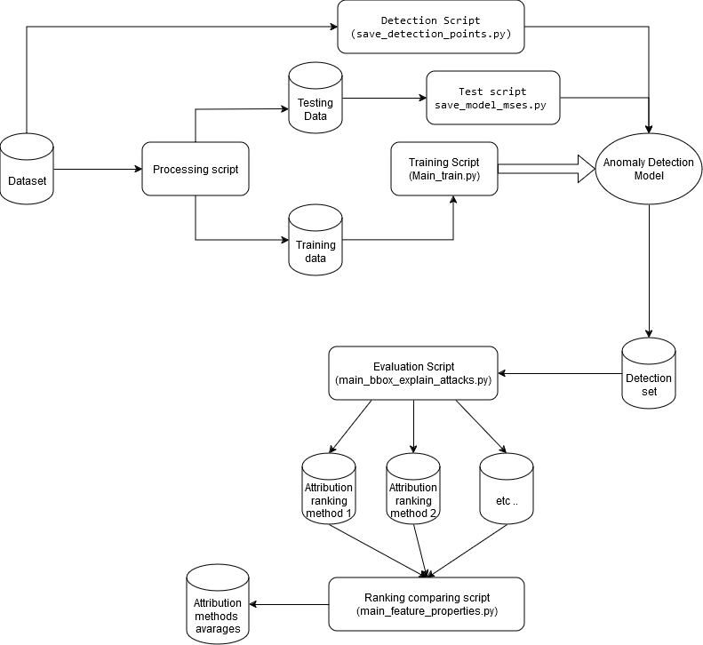
Workflow Diagram

Slide 14
Challenges
Processing time
01
Extremely taxing
Only increase accuracy
Not needed to reproducing conclusion
14 days estimate to fully test all data
Hashing values
02
Code was defective
Changes were necessary in file format

Slide 15
Limitations and Justifications
Only 1 attack is tested per dataset
Sufficient based on data from paper
Results can be directly compared
Not enough time or processing power
Similar methodology and attribution across attacks

Slide 16
Reproduction Conclusions
Confirmed paper findings
Taking into account traffic around starting time of the anomaly increases accuracy of attribution
MSE outperformed the rest of the methods under ideal conditions
SM outperformed the rest udder practical timing conditions
The collection of multiple methods (Ensemble) always outperformed individual methods
Testing values
Our values matched the papers testing procedure within the margin of error (SWAT attack 1) test

Slide 17
Key matrix to compare results
Metric | Definition | Purpose | Interpretation
Best-Guess Rank | Rank of the manipulated feature at the anomaly onset. | Evaluates performance under ideal conditions. | Lower rank = better identification at anomaly onset.
Practical Rank | Rank of the manipulated feature at the anomaly detection time. | Assesses performance under real-world conditions. | Lower rank = better identification post-detection.
Best-Guess Timing Rank | Average rank of the manipulated feature across time steps starting at anomaly onset. | Measures consistencyduring the early anomaly phase. | Lower value = more consistent early identification.
Practical Timing Rank | Average rank of the manipulated feature across time steps starting at anomaly detection. | Evaluates consistency under real-world conditions. | Lower value = better post-detection ranking stability.

Slide 18
Results: Reproduction vs Paper
Results are within acaptable margin of error based on paper recomendations
Method | Best guesss rank | Best parctical rank | Best guess timning rank | Best practical timning rank
MSE | 1 | 4 | 15.96 | 15.52
SM | 11 | 14 | 1.56 | 1.22
SHAP | 9 | 13 | 15.04 | 16.08
LEMNA | 7 | 9 | 12.77 | 13.79
Ensamble |  |  | 2.85 | 1.88
Method | Best guesss rank | Best parctical rank | Best guess timning rank | Best practical timning rank
MSE | 1 | 3 | 11.59 | 13.98
SM | 4 | 15 | 2.23 | 1.31
SHAP | 10 | 15 | 16.03 | 16.43
LEMNA | 7 | 9 | 12.84 | 13.79
Ensamble |  |  | 3.74 | 2.81
Reproduction
Paper

Slide 19
Optimization
Update code to use new libraries
Optimize code to run on GPUs
Use IDS specific attribution methods
Develop GUI for easier testing
Visulaise the attribution and the results of the testing

Slide 20
Takeaways
Sliding timefram is needed for roubust testing
Ideal and parctical conditions are needed to test how methods handle noise and early detection capabilities
Comparing multiple attribution methods is necessary as a baseline
A large dateset is required for optimal results
Longer tarinning and attribution testing will results in better accuracy

Slide 21
Takeaways
Key metrics to use in comparing attribution methods
Avarage rank based on ideal timing
Avarage rank based on parctical timing
Avarage ranking across mulitple attacks
Results normalization helps create a better and clearler observations

